Slide 1
BSE-18T State Machine Validation

Slide 2
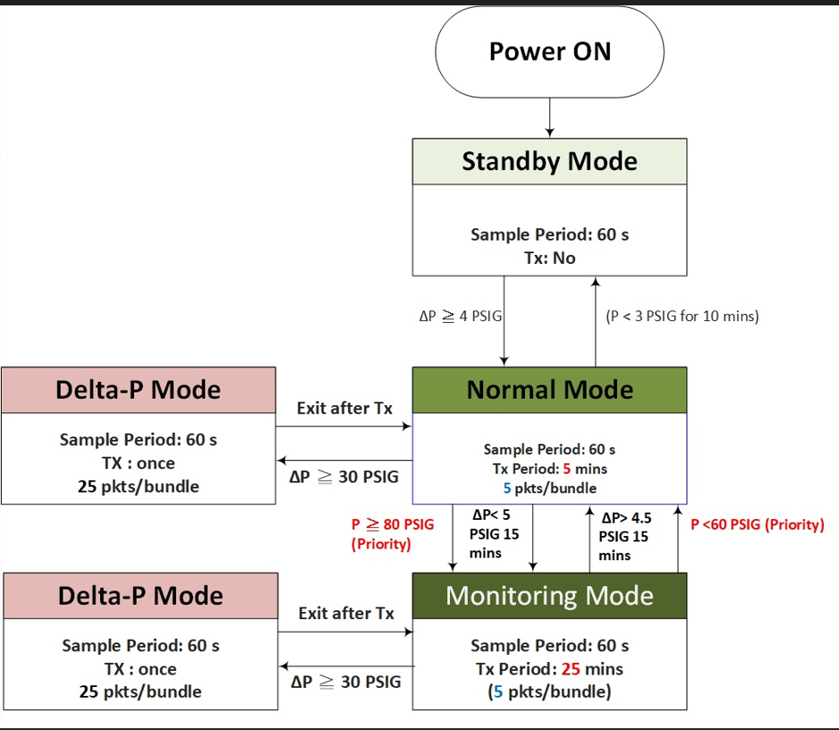
State Machine

Slide 3
INTRODUCTION
The Sensors with ID’s as shown below are updated with the new BSE18T HDS8_OTA_V07.0A_20250904.gbl firmware
78:1C:9D:7C:48:81
FC:4D:6A:E3:B7:0C
The following tests are performed on the Sensors
Standby to Normal to Standby
Normal to Delta P to Normal
Normal to Monitoring to Normal
Monitoring to Delta P to Monitoring

Slide 4
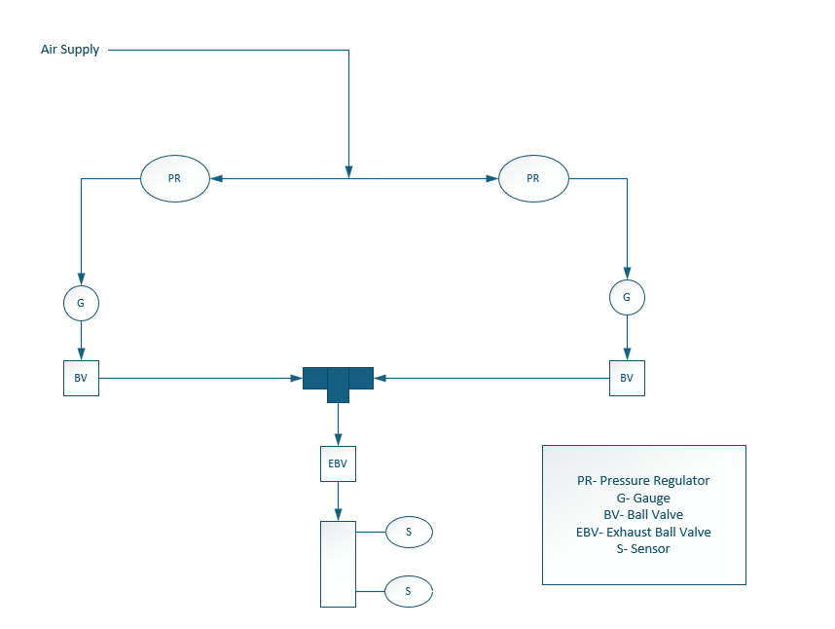
TEST SETUP

Slide 5
STANDBY to NORMAL to STANDBY(B7:0C)
Time | Pressure Applied | Mode | No of Packets ch 37 | No of Packets ch 38 | No of packets ch 39 | Pressure on BLE | Time Delta
10:00 AM | 0 PSI | STANDBY
10:09 AM | 10 PSI
10:10 AM | 10 PSI | Normal | 3 | 3 | 0 | 9.42 PSI | 0
10:15 AM | 10 PSI | Normal | 1 | 4 | 1 | 9.42 PSI | 5 min
10:20 AM | 0 PSI
10:20 AM | 0 PSI | Normal | 4 | 4 | 1 | 0 PSI | 5 min
10:25 AM | 0 PSI | Normal | 2 | 4 | 0 | 0 PSI | 5 min
10:30 AM | 0 PSI
No TX from the Sensor
Changed pressure from 0 PSI to 10 PSI
Changed pressure from 10 PSI to 0 PSI
No TX from the Sensor (Should I expect one more Normal Mode Tx?)

Slide 6
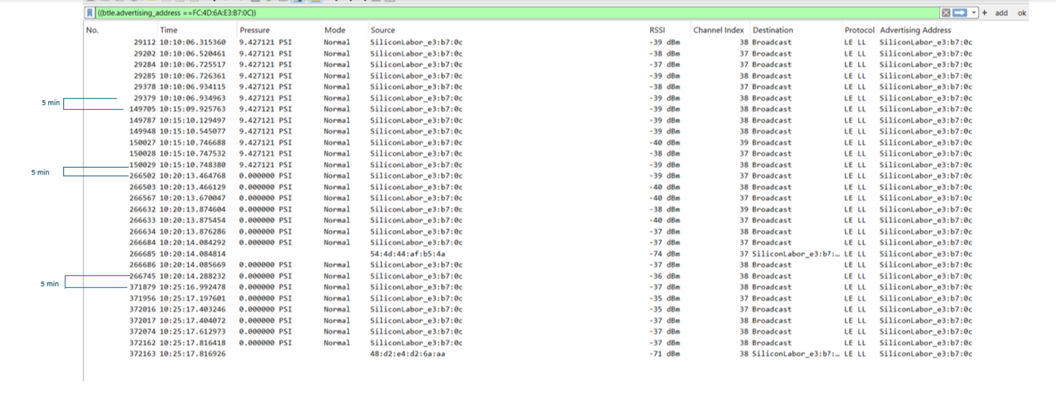
STANDBY to NORMAL to STANDBY(B7:0C)

Slide 7
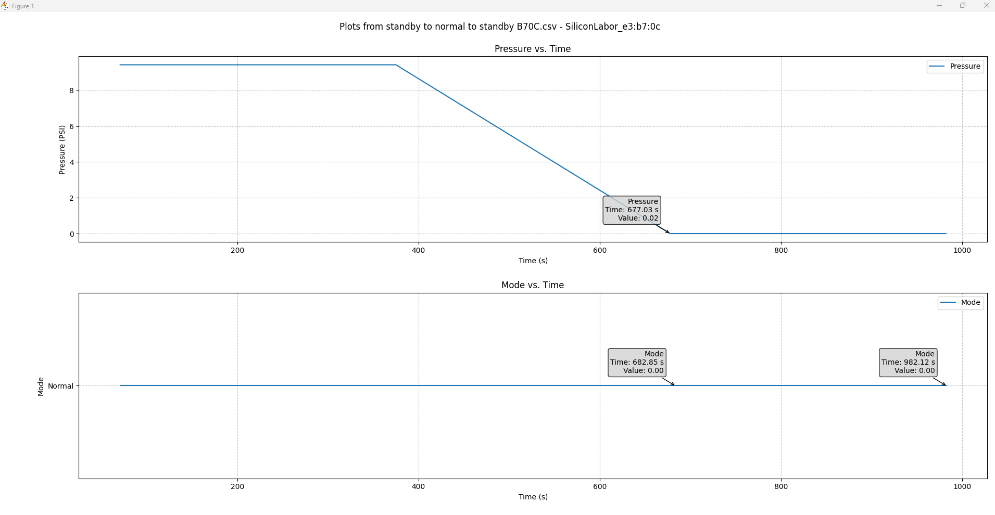
STANDBY to NORMAL to STANDBY(B7:0C)
5 min
Only lasted in Normal Mode for 5 mins at 0 PSI

Slide 8
STANDBY to NORMAL to STANDBY(48:81)
Time | Pressure Applied | Mode | No of packets ch 37 | No of packets ch 38 | No of packets ch 39 | Pressure on BLE | Time Delta
10:00 AM | 0 PSI | STANDBY
10:09 AM | 10 PSI
10:09 AM | 10 PSI | NORMAL | 2 | 2 | 2 | 9.78 PSI | 0
10:14 AM | 10 PSI | NORMAL | 3 | 3 | 2 | 9.42 PSI | 5 min
10:19 AM | 10 PSI | NORMAL | 2 | 2 | 1 | 9.42 PSI | 5 min
10:20 AM | 0 PSI
10:24 AM | 0 PSI | NORMAL | 4 | 2 | 0 | 0 PSI | 5 min
10:29 AM | 0 PSI
No TX from the Sensor
Changed pressure from 0 PSI to 10 PSI
Changed pressure from 10 PSI to 0 PSI
No TX from the Sensor (Should I expect one more Normal Mode Tx?)

Slide 9
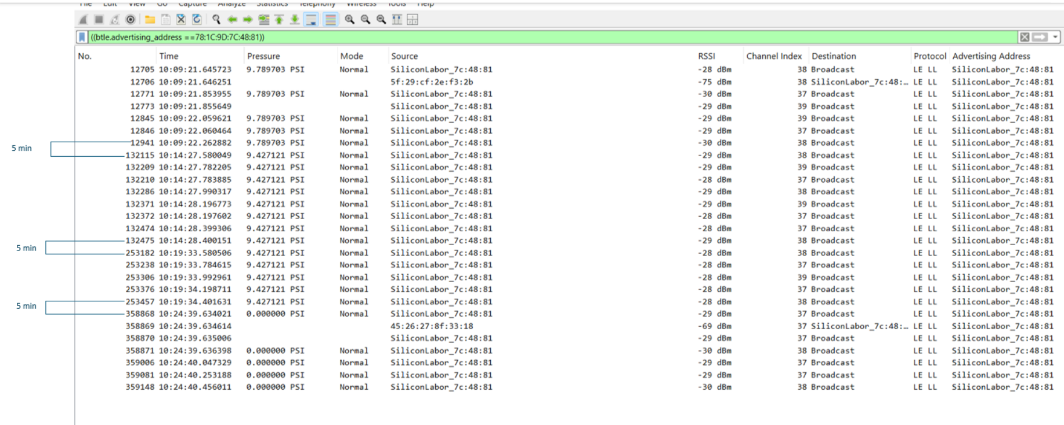
STANDBY to NORMAL to STANDBY(48:81)

Slide 10
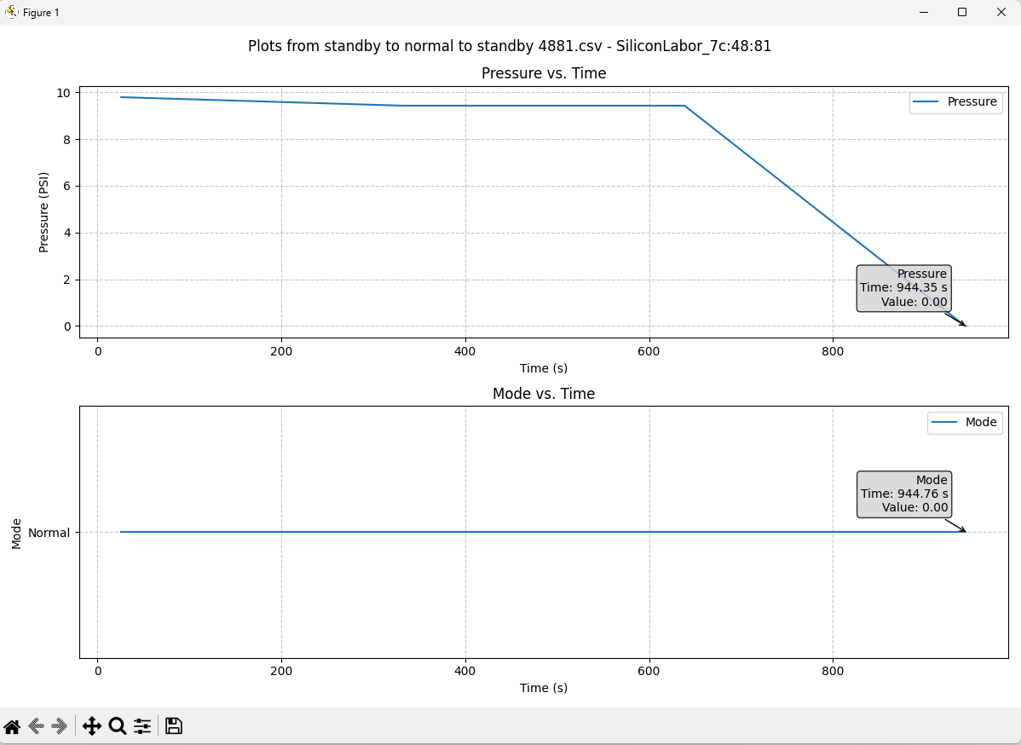
STANDBY to NORMAL to STANDBY(48:81)

Slide 11
Conclusion
Standby Mode✓
The Sensor does not transmit any advertisements during Standby Mode for both the Sensors
Standby to Normal Mode(Δ P ≥ 4PSI) ✓
When the pressure was increased from 0 PSI to 10 PSI both the Sensors go into Normal Mode
The Normal Mode advertisements are transmitted every 5 mins
Normal to Standby Mode(P<3 PSI for 10 mins) -?
Sensor B7:0C- At 10:30 AM, do we expect the Sensor to transmit one more normal mode adv?)
Sensor 48:81- At 10:29 AM, do we expect the Sensor to transmit one more normal mode adv?)

Slide 12
Normal to Delta P to Normal(B7:0C)
Time | Pressure Applied | Mode | No of packets ch 37 | No of packets ch 38 | No of packets ch 39 | Pressure on BLE | Time Delta
11:28 AM | 10 PSI | NORMAL | 3 | 1 | 0 | 9.42 PSI | 0
11:29 AM | 50 PSI
11:30 AM | 50 PSI | DELTA P | 9 | 9 | 9 | 50.03 PSI | 1 min
11:33 AM | 50 PSI | NORMAL | 4 | 6 | 1 | 50.03 PSI | 3 min
11:38 AM | 50 PSI | NORMAL | 1 | 3 | 0 | 50.03 PSI | 5 min
11:38 AM | 10 PSI
11:39 AM | 10 PSI | DELTA P | 10 | 11 | 9 | 9.42 PSI | 1 min
11:43 AM | 10 PSI | NORMAL | 3 | 4 | 4 | 9.42 PSI | 4 min
11:48 AM | 10 PSI | NORMAL | 3 | 2 | 2 | 9.42 PSI | 5 min
Increased Pressure from 10 PSI to 50 PSI
Delta P 5 secs
Decreased Pressure from 10 PSI to 50 PSI
Delta P 5 secs

Slide 13
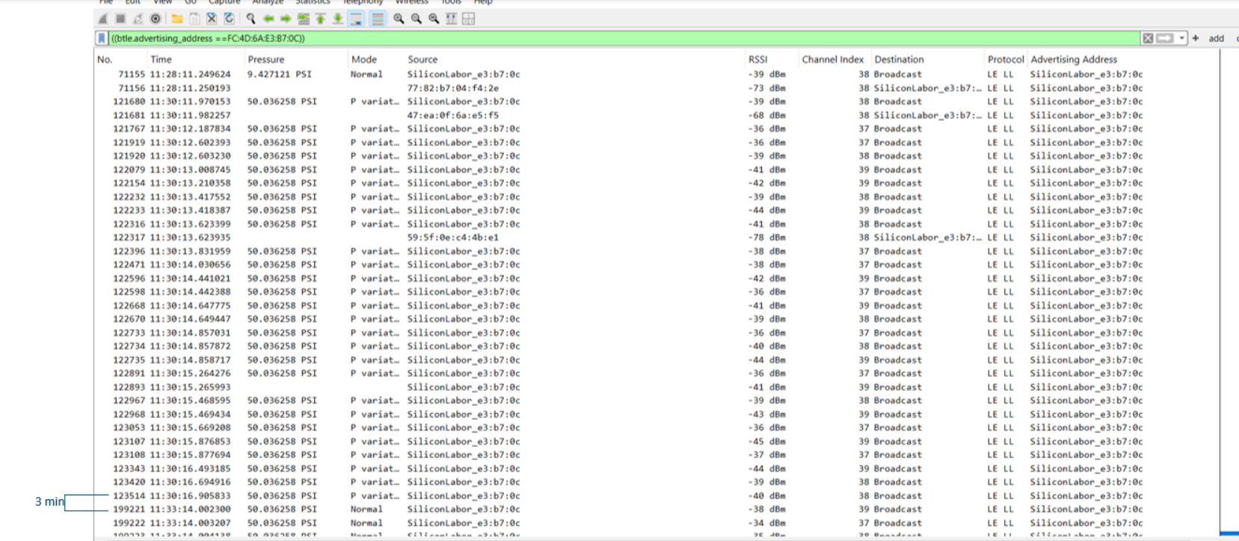
Normal to Delta P to Normal(B7:0C)

Slide 14
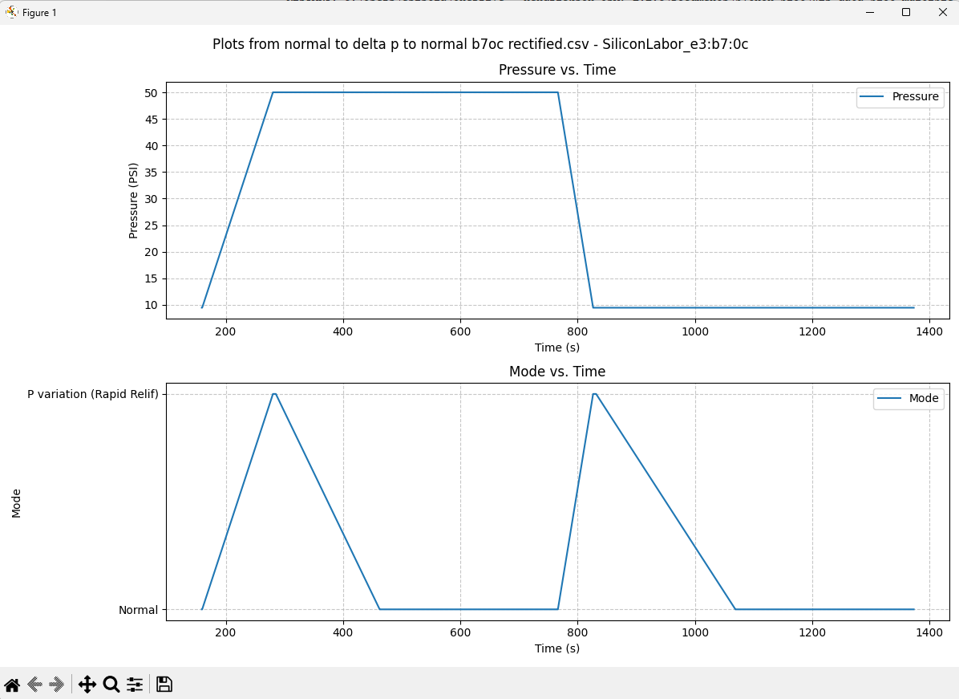
Normal to Delta P to Normal(B7:0C)
3 min
4 min

Slide 15
Normal to Delta P to Normal(48:81)
Time | Pressure Applied | Mode | No of packets ch 37 | No of packets ch 38 | No of packets ch 39 | Pressure on BLE | Time Delta
11:29 AM | 10 PSI | NORMAL | 2 | 3 | 1 | 9.42 PSI | 0
11:29 AM | 50 PSI
11:30 AM | 50 PSI | DELTA P | 12 | 7 | 9 | 50.03 PSI | 1 min
11:34 AM | 50 PSI | NORMAL | 2 | 3 | 1 | 50.03 PSI | 4 min
11:38 AM | 10 PSI
11:39 AM | 10 PSI | DELTA P | 9 | 7 | 7 | 9.42 PSI | 1 min
11:39 AM | 10 PSI | NORMAL | 2 | 2 | 2 | 9.42 PSI
11:44 AM | 10 PSI | NORMAL | 1 | 3 | 2 | 9.42 PSI | 5 min
11:49 AM | 10 PSI | NORMAL | 2 | 3 | 0 | 9.42 PSI | 5 min
Increased Pressure from 10 PSI to 50 PSI
Delta P 5 secs
Decreased Pressure from 50 PSI to 10 PSI
Delta P 5 secs

Slide 16
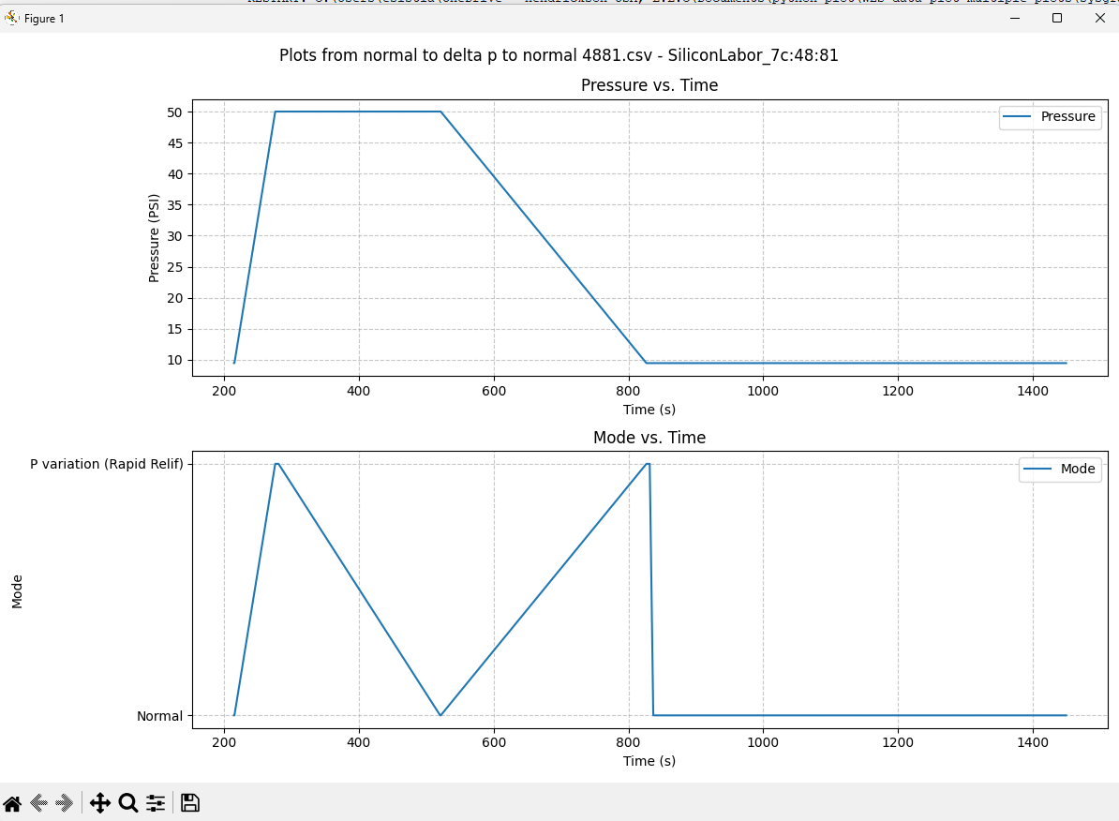
Normal to Delta P to Normal(48:81)

Slide 17
Conclusion
Normal Mode✓
Both the Sensors advertised every 5 mins in Normal Mode as per the State Machine
Delta P Mode(ΔP ≥ 30 PSI)✓
Both the Sensors entered Delta P Mode when the pressure was increased from 10 PSI to 50 PSI.
The Delta P time observed for both the Sensors was 5 seconds in total
Delta P Mode to Normal Mode✓
Both the Sensors exited from Delta P Mode back to Normal Mode as per the State Machine

Slide 18
Normal to Monitoring to Normal(B7:0C)
Condition Tested-
Normal to Monitoring(P≥80 PSI)
Monitoring to Normal(P<60 PSI)
Time | Pressure Applied | Mode | No of Packets ch 37 | No of Packets ch 38 | No of Packets ch 39 | Pressure on BLE | Time Delta
7:52 AM | 70 PSI | NORMAL | 4 | 3 | 1 | 70.34 PSI | 3 min
7:57 AM | 70 PSI | NORMAL | 2 | 2 | 1 | 70.34 PSI | 5 min
7:57 AM | 85 PSI
7:58 AM | 85 PSI | MONITORING | 3 | 5 | 3 | 84.84 PSI | 1 min
8:23 AM | 85 PSI | MONITORING | 3 | 2 | 1 | 84.84 PSI | 25 min
8:49 AM | 85 PSI | MONITORING | 1 | 2 | 1 | 84.84 PSI | 25 min
Increased pressure from 70 PSI to 85 PSI

Slide 19
Normal to Monitoring to Normal(B7:0C)
Time | Pressure Applied | Mode | No of Packets ch 37 | No of Packets ch 38 | No of Packets ch 39 | Pressure on BLE | Time Delta
9:14 AM | 85 PSI | MONITORING | 3 | 4 | 2 | 84.84 PSI | 25 min
9:17 AM | 50 PSI
9:18 AM | 50 PSI | NORMAL | 3 | 5 | 1 | 50.03 PSI | 4 min
9:23 AM | 50 PSI | NORMAL | 3 | 4 | 1 | 50.03 PSI | 5 min
Decreased pressure from 85 PSI to 50 PSI

Slide 20
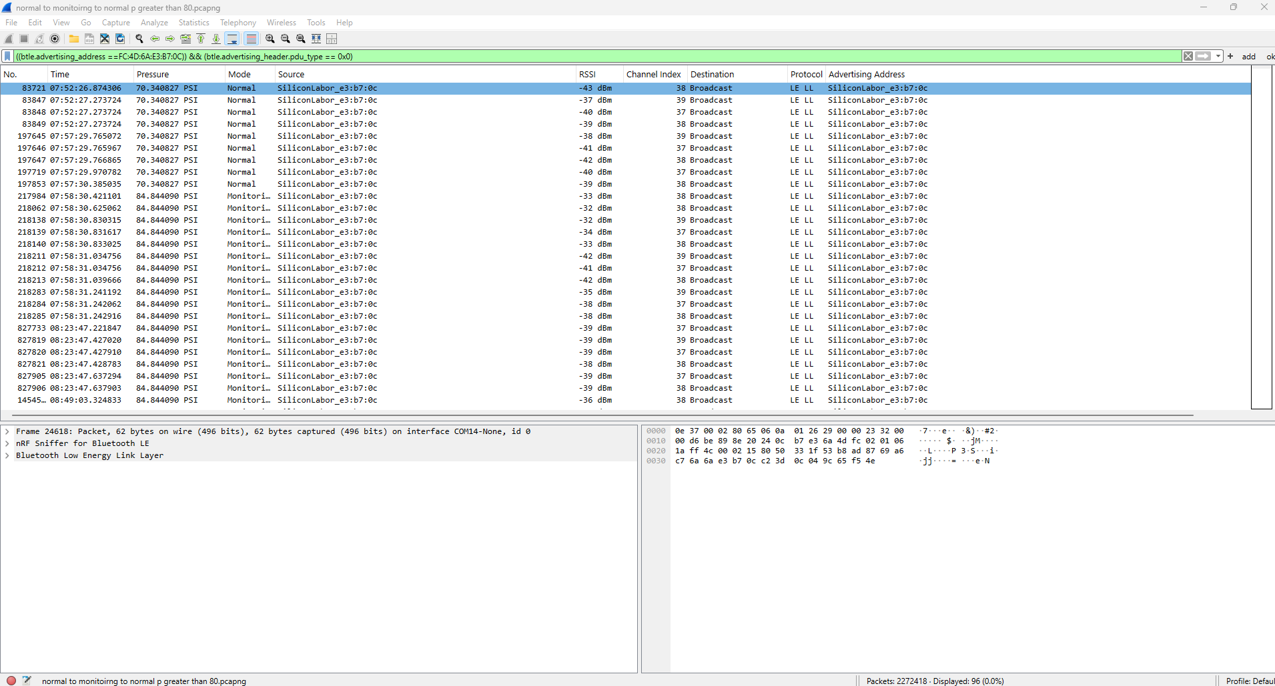
Normal to Monitoring to Normal(B7:0C)
Normal to Monitoring

Slide 21
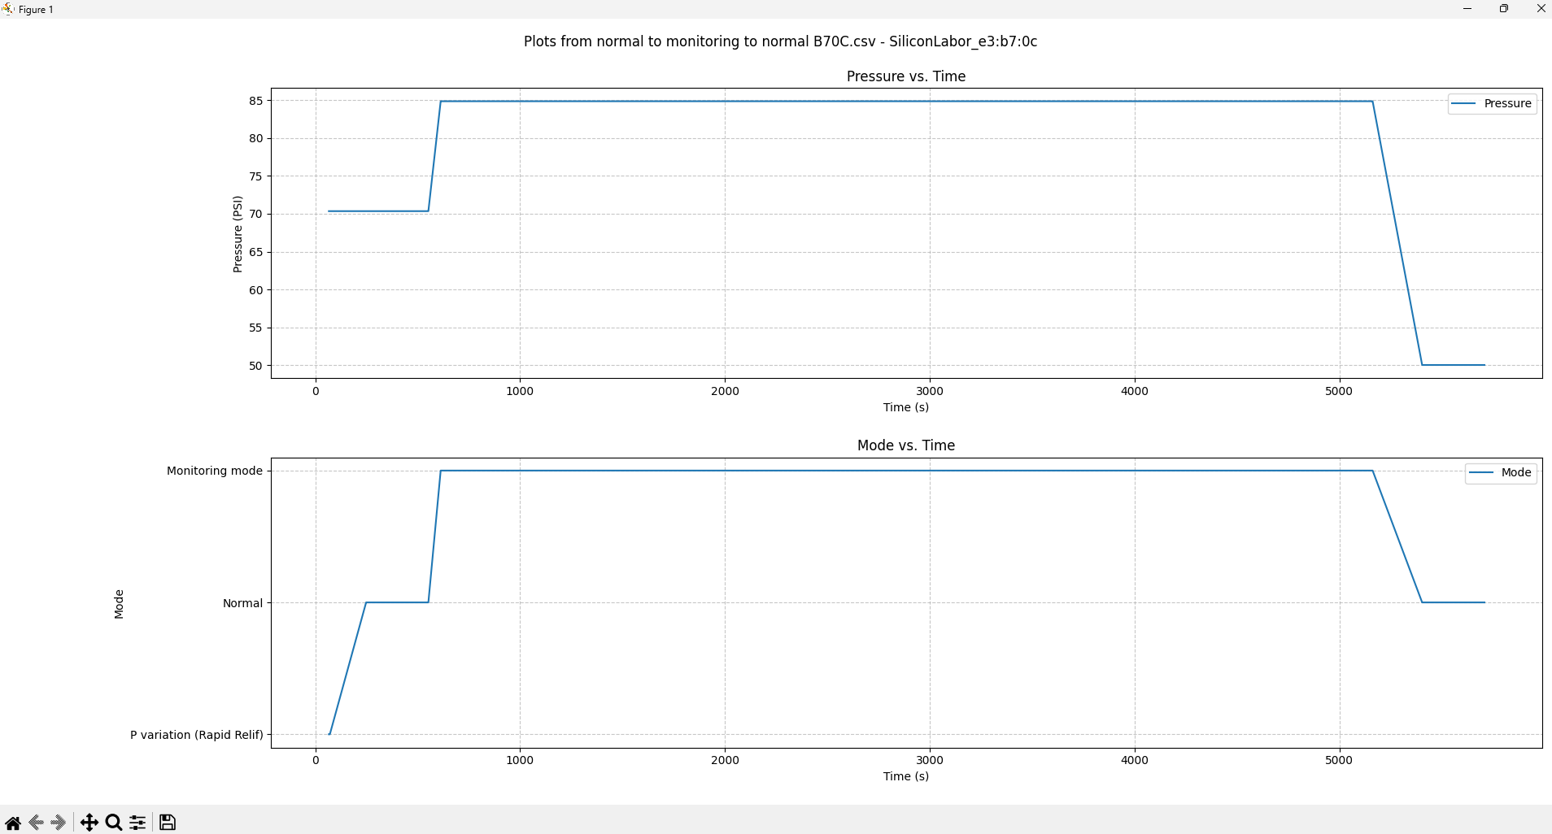
Normal to Monitoring to Normal(B7:0C)

Slide 22
Normal to Monitoring to Normal(48:81)
Time | Pressure Applied | Mode | No of packets ch 37 | No of packets ch 38 | No of packets ch 39 | Pressure on BLE | Time Delta
7:52 AM | 70 PSI | NORMAL | 1 | 2 | 1 | 70.34 PSI | 0
7:57 AM | 70 PSI | NORMAL | 0 | 2 | 2 | 70.34 PSI | 5 min
7:57 AM | 85 PSI
7: 58 AM | 85 PSI | MONITORING | 2 | 2 | 2 | 84.84 PSI | 1 min
8:24 AM | 85 PSI | MONITORING | 4 | 2 | 4 | 84.84 PSI | 25 min
8:49 AM | 85 PSI | MONITORING | 1 | 2 | 3 | 84.84 PSI | 25 min
9:15 AM | 85 PSI | MONITORING | 2 | 1 | 2 | 84.84 PSI | 25 min
9:17 AM | 50 PSI
9:18 AM | 50 PSI | NORMAL | 4 | 4 | 3 | 50.03 PSI | 1 min
9:23 AM | 50 PSI | NORMAL | 2 | 3 | 1 | 50.03 PSI | 5 min
Increased pressure from 70 to 85 PSI
Decreased pressure from 85 PSI to 50 PSI

Slide 23
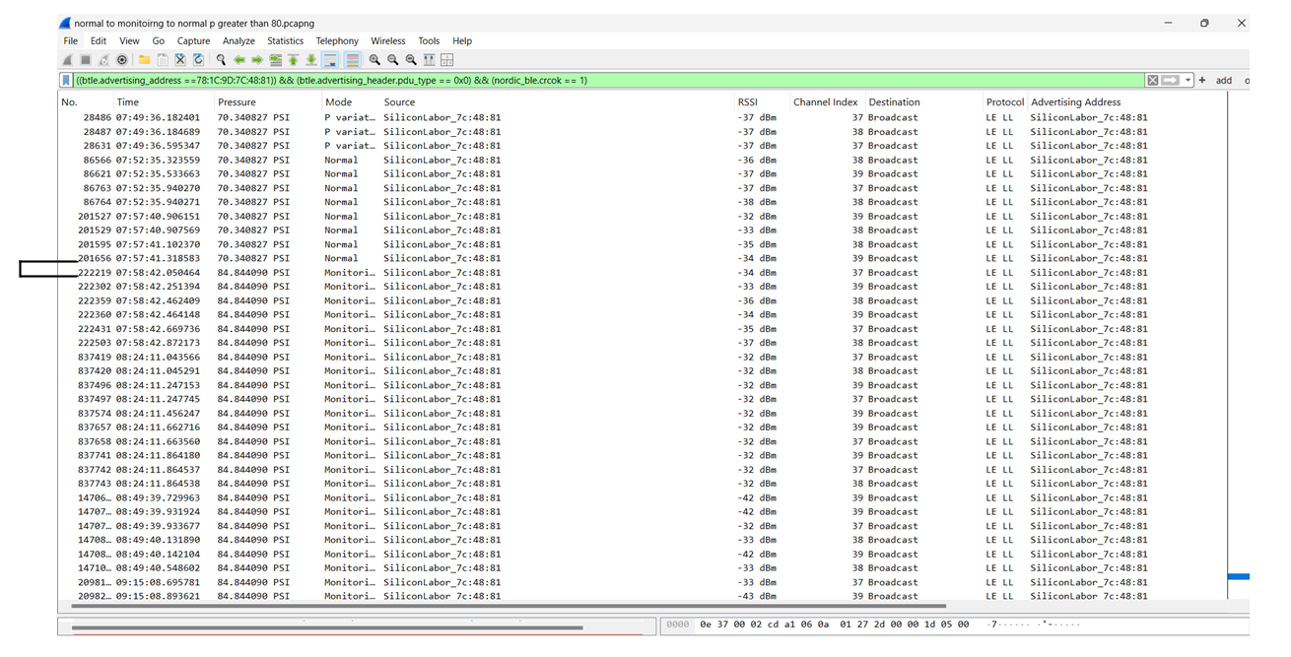
Normal to Monitoring to Normal(48:81)
Normal to Monitoring

Slide 24
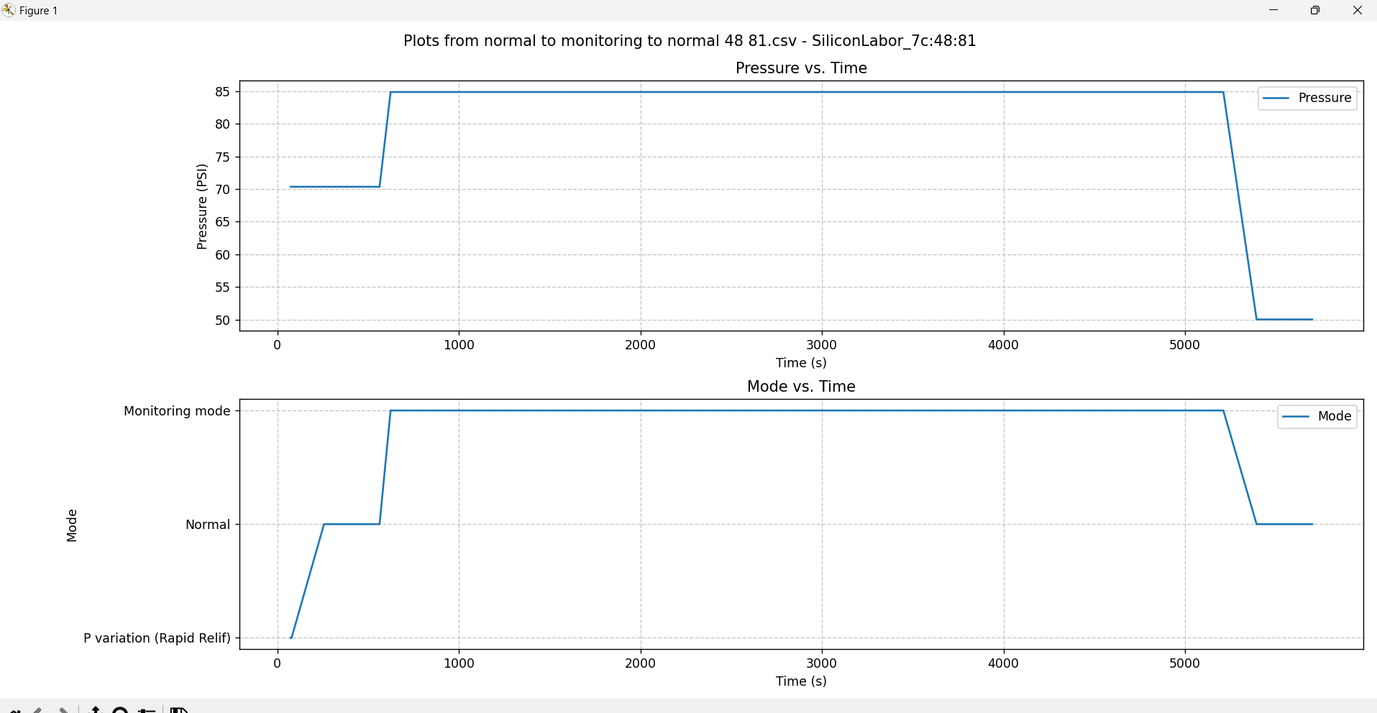
Normal to Monitoring to Normal(48:81)

Slide 25
Conclusion
Normal Mode✓
Both the Sensors advertised every 5 mins in Normal Mode as per the State Machine
Normal to Monitoring Mode(P≥80 PSI) ✓
Both the Sensors enter Monitoring Mode from Normal Mode when the Pressure applied to the Sensors is increased beyond 80 PSI
Both the Sensors transmitted every 25 mins in Monitoring Mode as per the State Machine
Monitoring Mode to Normal Mode(P<60 PSI) ✓
Both the Sensors returned to Normal Mode from Monitoring Mode when the Pressure Applied was less than 60 PSI

Slide 26
Normal to Monitoring to Normal(B7:0C)
Condition Tested
Normal to Monitoring(ΔP<5 PSI for 15 mins)
Monitoring to Normal(ΔP>4.5 PSI for 15 mins)
Time | Pressure Applied | Mode | No of packets ch 37 | No of packets ch 38 | No of packets ch 39 | Pressure on BLE | Time Delta
1:09 PM | 50 PSI
1:10 PM | 50 PSI | NORMAL | 1 | 5 | 1 | 50.03 PSI | 0
1:15 PM | 50 PSI | NORMAL | 1 | 3 | 1 | 50.03 PSI | 5 min
1:20 PM | 50 PSI | NORMAL | 1 | 3 | 0 | 50.03 PSI | 5 min
1:20 PM | 51 PSI
1:21 PM | 52 PSI
1:22 PM | 53 PSI
Increased pressure from 0(Standby) to 50 PSI
Increased pressure from 50 to 51 PSI
Increased pressure from 51 to 52 PSI
Increased pressure from 52 to 53 PSI

Slide 27
Normal to Monitoring to Normal(B7:0C)
Time | Pressure Applied | Mode | No of packets ch 37 | No of packets ch 38 | No of packets ch 39 | Pressure on BLE | Time Delta
1:23 PM | 54 PSI
1:25 PM | 54 PSI | NORMAL | 4 | 4 | 4 | 53.66 PSI | 5 min
1:26 PM | 54 PSI | MONITORING | 1 | 3 | 1 | 53.66 PSI | 1 min
1:27 PM | 54 PSI | NORMAL | 1 | 1 | 1 | 53.66 PSI | 1 min
1:32 PM | 54 PSI | NORMAL | 2 | 2 | 1 | 53.66 PSI | 5 min
1:37 PM | 54 PSI | NORMAL | 3 | 4 | 1 | 53.66 PSI | 5 min
Increased pressure from 53 to 54 PSI

Slide 28
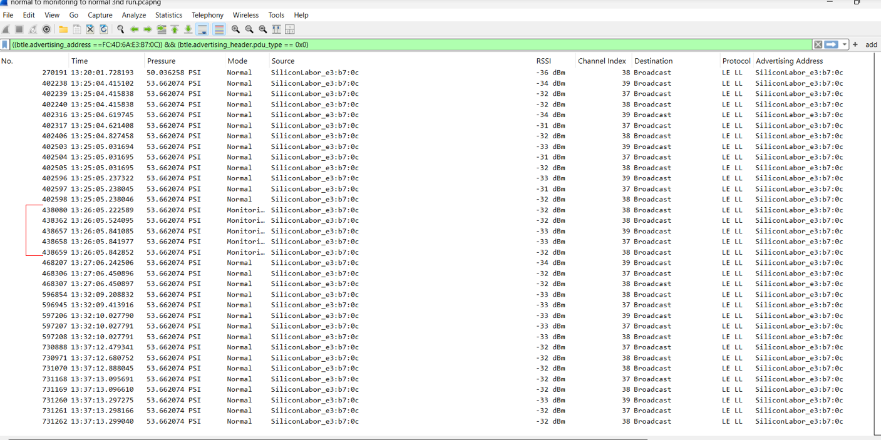
Normal to Monitoring to Normal(B7:0C)

Slide 29
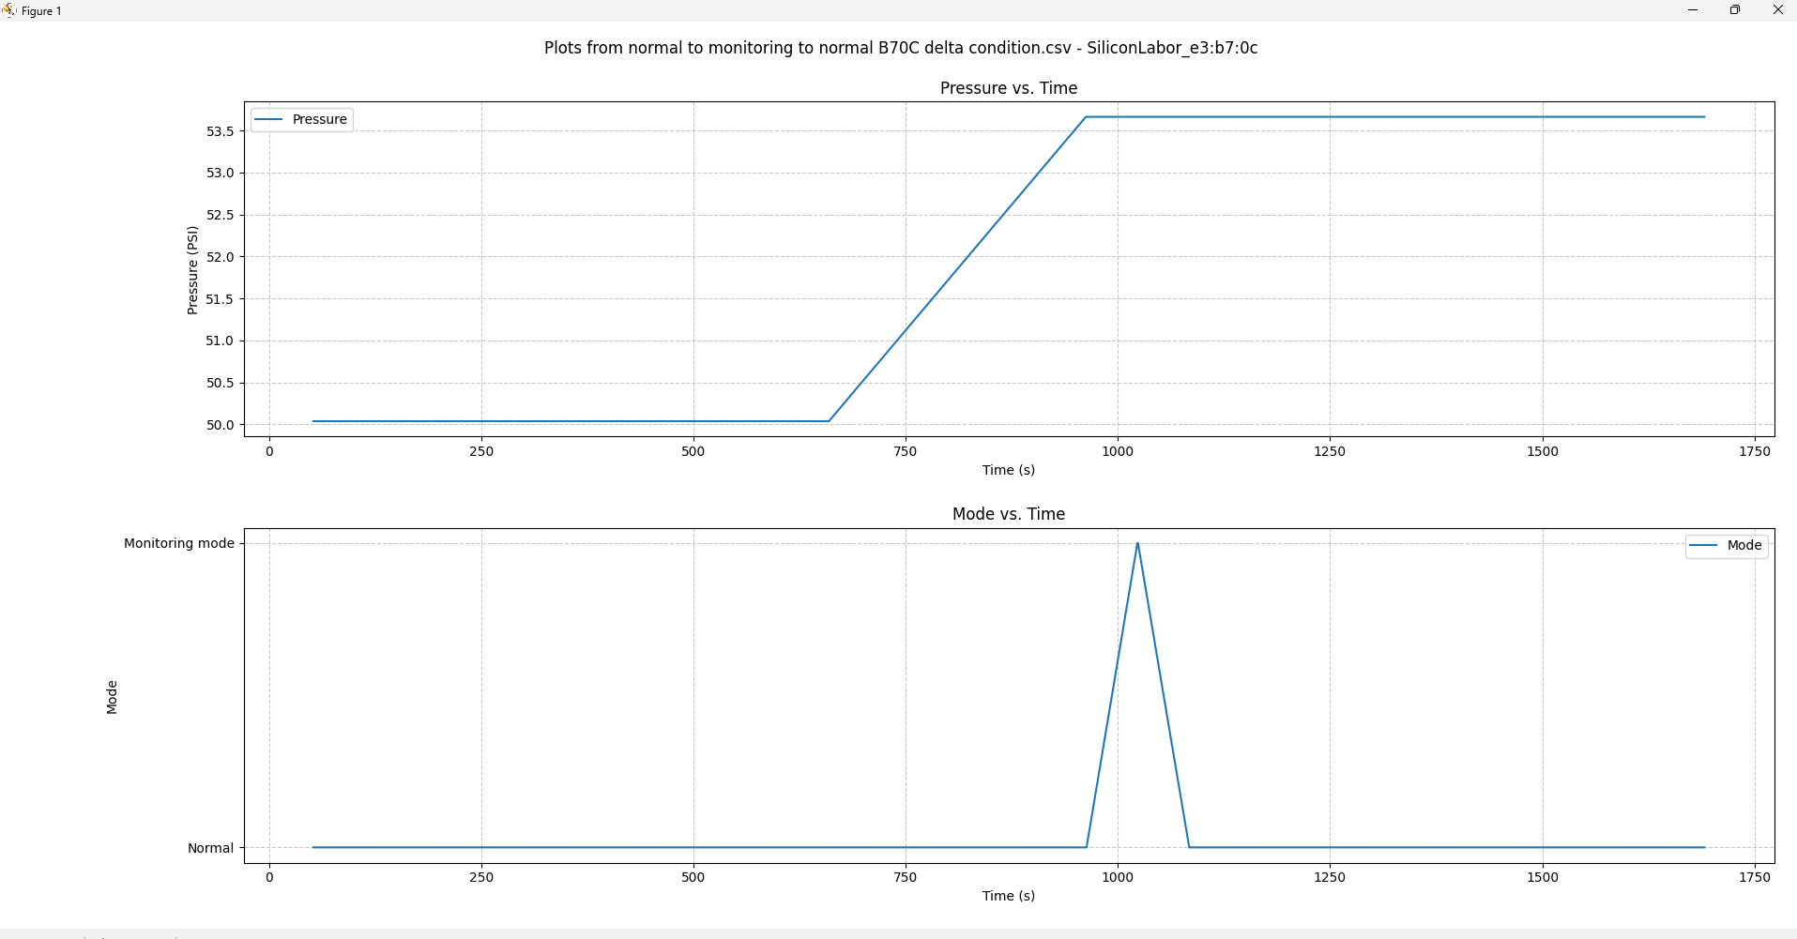
Normal to Monitoring to Normal(B7:0C)

Slide 30
Normal to Monitoring to Normal(48:81)
Time | Pressure Applied | Mode | No of packets ch 37 | No of packets ch 38 | No of packets ch 39 | Pressure on BLE | Time Delta
1:09 PM | 50 PSI
1:09 PM | 50 PSI | NORMAL | 5 | 2 | 1 | 50.03 PSI | 0
1:14 PM | 50 PSI | NORMAL | 3 | 3 | 1 | 50.03 PSI | 5 min
1:19 PM | 50 PSI | NORMAL | 3 | 3 | 1 | 50.03 PSI | 5 min
1:20 PM | 51 PSI
1:21 PM | 52 PSI
1:22 PM | 53 PSI
1:23 PM | 54 PSI
1:25 PM | 54 PSI | NORMAL | 3 | 2 | 3 | 53.66 PSI | 5 min
Increased pressure from 0(Standby) to 50 PSI
Increased pressure from 50 to 51 PSI
Increased pressure from 51 to 52 PSI
Increased pressure from 52 to 53 PSI
Increased pressure from 53 to 54 PSI

Slide 31
Normal to Monitoring to Normal(48:81)
Time | Pressure Applied | Mode | No of packets ch 37 | No of packets ch 38 | No of packets ch 39 | Pressure on BLE | Time Delta
1:26 PM | 54 PSI | MONITORING | 0 | 0 | 3 | 53.29 PSI | 1 min
1:27 PM | 54 PSI | NORMAL | 4 | 1 | 1 | 53.66 PSI | 1 min
1:32 PM | 54 PSI | NORMAL | 3 | 2 | 3 | 53.29 PSI | 5 min
1:37 PM | 54 PSI | NORMAL | 0 | 1 | 1 | 53.29 PSI | 5 min

Slide 32
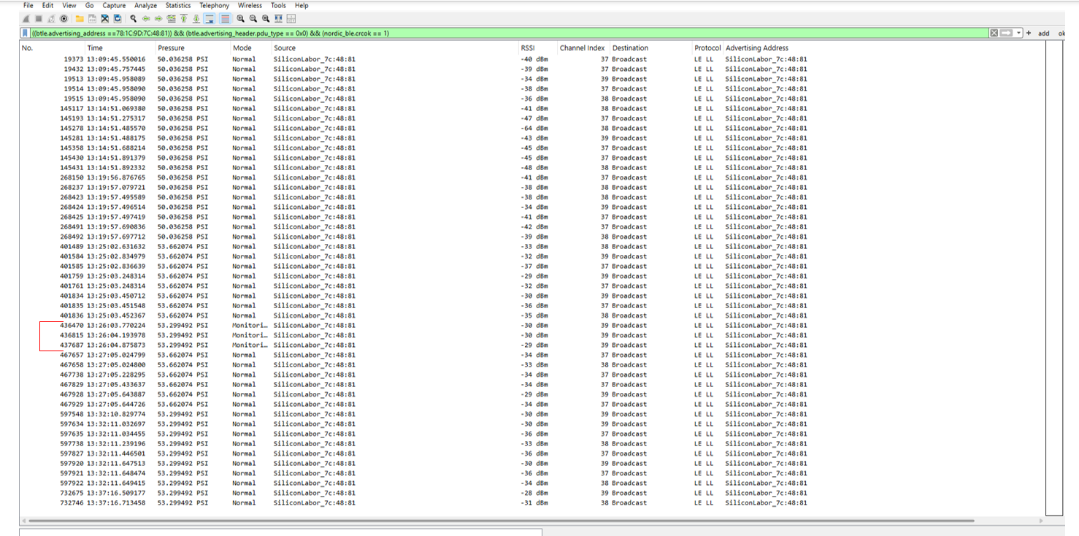
Normal to Monitoring to Normal(48:81)

Slide 33
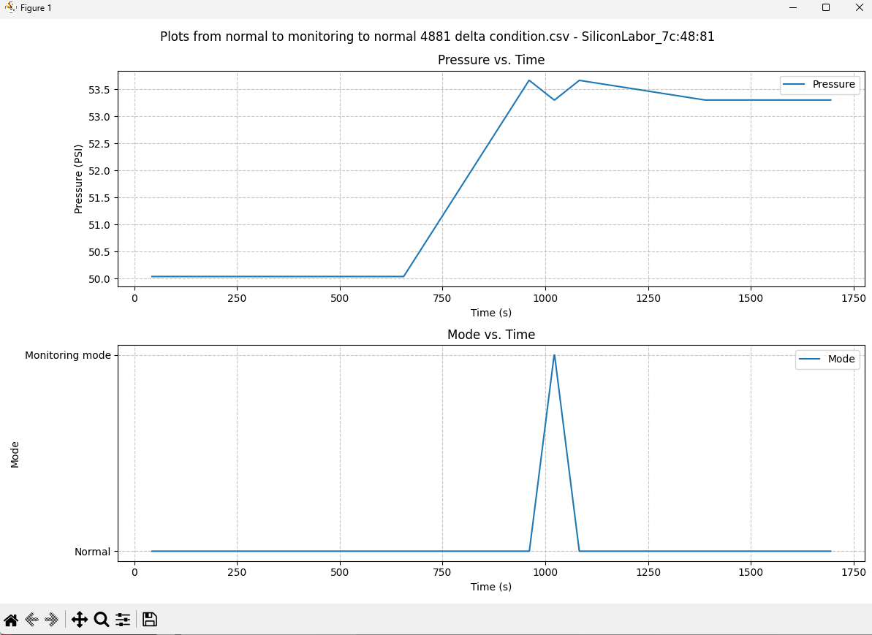
Normal to Monitoring to Normal(48:81)

Slide 34
Conclusion
Normal Mode✓
Both the Sensors advertised every 5 mins in Normal Mode as per the State Machine
Normal Mode to Monitoring Mode (ΔP<5 PSI for 15 mins) X
Both the Sensors do not satisfy this condition
Why did Sensor B7:0C enter Monitoring Mode at 1:26 PM and exit Monitoring Mode at 1:27 PM?
Why did Sensor 48:81 enter Monitoring Mode at 1:26 PM and exit Monitoring Mode at 1:27 PM?

Slide 35
Normal to Monitoring to Normal(B7:0C)- Repeat
Time | Pressure Applied | Mode | No of packets ch 37 | No of packets ch 38 | No of packets ch 39 | Pressure on BLE | Time Delta
10:39 AM | 54 PSI | NORMAL | 4 | 3 | 0 | 53.29 PSI | 0
10:44 AM | 57 PSI
10:44 AM | 57 PSI | NORMAL | 3 | 5 | 2 | 53.29 PSI | 5 min
10:49 AM | 57 PSI | NORMAL | 4 | 3 | 1 | 56.56 PSI | 5 min
10:54 AM | 57 PSI | MONITORING | 2 | 5 | 1 | 56.56 PSI | 5 min
10:55 PM | 57 PSI | NORMAL | 2 | 3 | 0 | 56.56 PSI | 1 min
11:00 PM | 57 PSI | NORMAL | 3 | 3 | 2 | 56.56 PSI | 5 min
11:05 PM | 57 PSI | NORMAL | 3 | 4 | 1 | 56.56 PSI | 5 min
11:10 PM | 57 PSI | MONITORING | 3 | 3 | 0 | 56.56 PSI | 5 min
11:11 PM | 57 PSI | NORMAL | 3 | 4 | 0 | 56.56 PSI | 1 min
Increase pressure from 54 PSI to 57 PSI

Slide 36
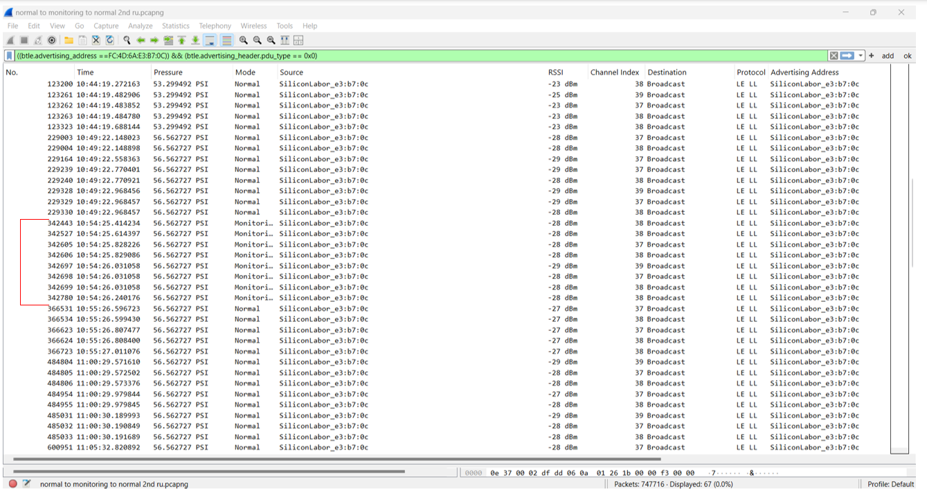
Normal to Monitoring to Normal(B7:0C)- Repeat

Slide 37
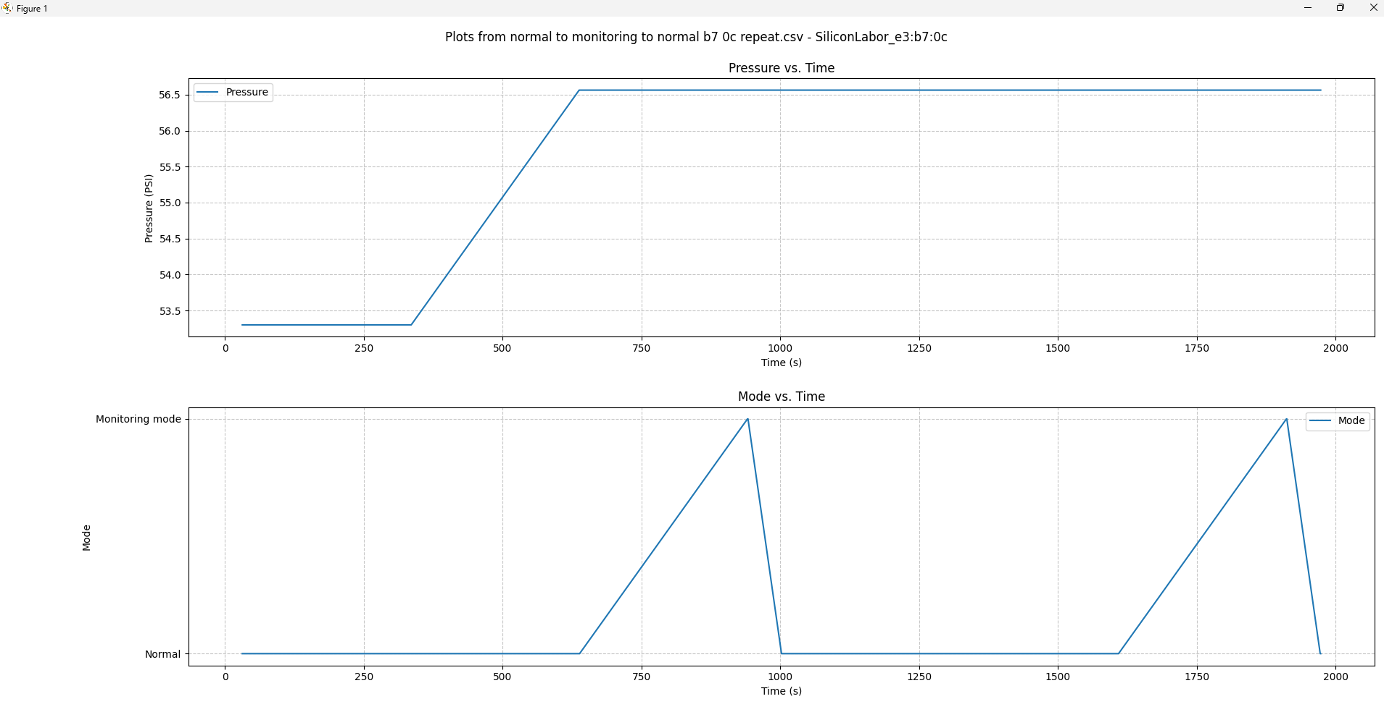
Normal to Monitoring to Normal(B7:0C)- Repeat

Slide 38
Normal to Monitoring to Normal(48:81)- Repeat
Time | Pressure Applied | Mode | No of packets ch 37 | No of packets ch 38 | No of packets ch 39 | Pressure on BLE | Time Delta
10:39 AM | 54 PSI | NORMAL | 1 | 2 | 2 | 53.29 PSI | 0
10:44 AM | 57 PSI
10:44 AM | 57 PSI | NORMAL | 4 | 2 | 0 | 56.56 PSI | 5 min
10:49 AM | 57 PSI | NORMAL | 3 | 4 | 2 | 56.56 PSI | 5 min
10:55 AM | 57 PSI | MONITORING | 1 | 1 | 1 | 56.56 PSI | 5 min
10:56 AM | 57 PSI | NORMAL | 1 | 2 | 2 | 56.56 PSI | 1 min
11:01 AM | 57 PSI | NORMAL | 3 | 2 | 0 | 56.56 PSI | 5 min
11:06 AM | 57 PSI | NORMAL | 2 | 3 | 1 | 56.56 PSI | 5 min
11:11 AM | 57 PSI | MONITORING | 2 | 3 | 1 | 56.56 PSI | 5 min
11:12 AM | 57 PSI | NORMAL | 3 | 3 | 2 | 56.56 PSI | 1 min
Increase pressure from 54 PSI to 57 PSI

Slide 39
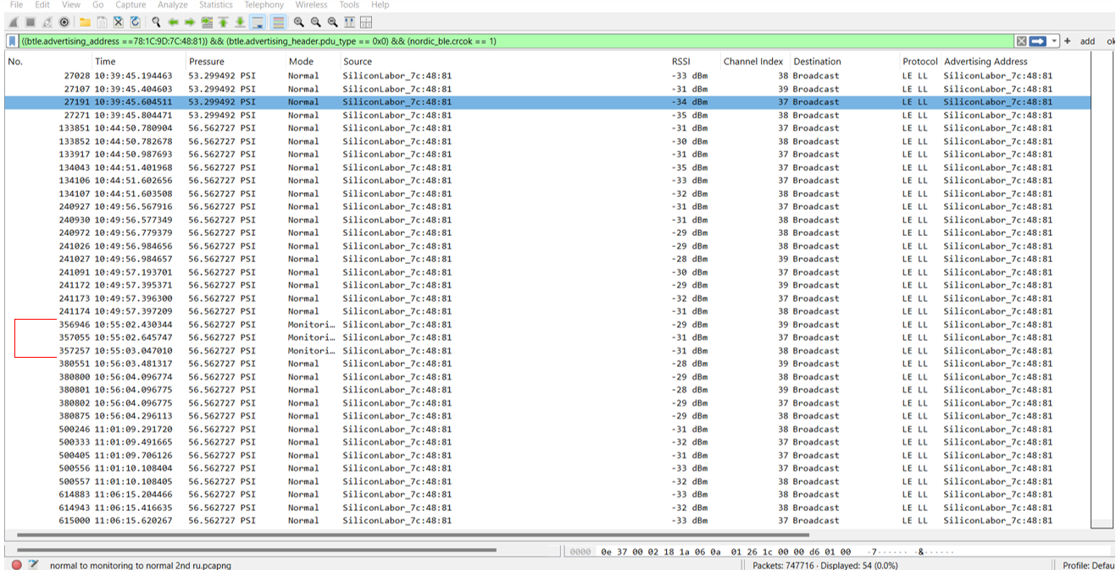
Normal to Monitoring to Normal(48:81)- Repeat

Slide 40
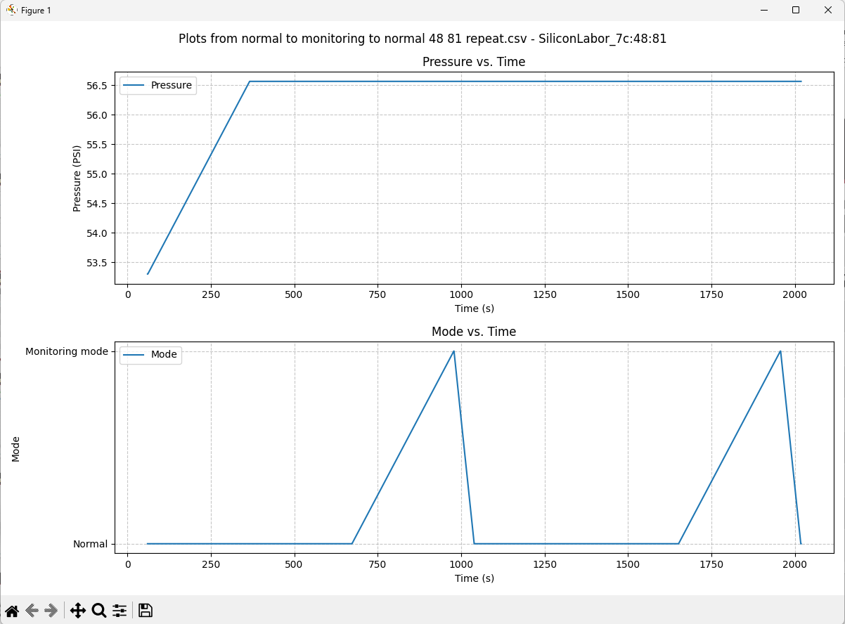
Normal to Monitoring to Normal(48:81)- Repeat

Slide 41
Conclusion
Normal Mode✓
Both the Sensors advertised every 5 mins in Normal Mode as per the State Machine
Normal Mode to Monitoring Mode (ΔP<5 PSI for 15 mins) X
Both the Sensors do not satisfy this condition
Why did the Sensor B7:0C enter Monitoring Mode at 10:54 AM? And 11:10 AM?
Why did the Sensor 48:81 enter Monitoring Mode at 10:55 AM? and 11:11 AM?

Slide 42
Monitoring to Delta P to Monitoring(B7:0C)
Time | Pressure Applied | Mode | No of packets ch 37 | No of packets ch 38 | No of packets ch 39 | Pressure on BLE | Time Delta
8:53 AM | 85 PSI | MONITORING | 3 | 4 | 1 | 84.48 PSI | 0
9:18 AM | 85 PSI | MONITORING | 0 | 1 | 0 | 84.48 PSI | 25 min
9:22 AM | 120 PSI
9:22 AM | 120 PSI | DELTA P | 13 | 6 | 9 | 119.65 PSI | 4 min
9:37 AM | 120 PSI | NORMAL | 3 | 3 | 4 | 119.65 PSI | 15 min
9:38 AM | 120 PSI | MONITORING | 3 | 3 | 4 | 119.65 PSI | 1 min
Increased pressure from 85 PSI to 120 PSI
Expected Monitoring Mode at 9:43

Slide 43
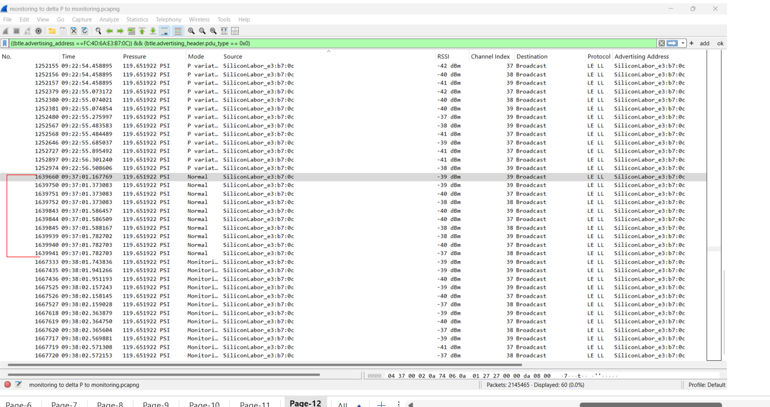
Monitoring to Delta P to Monitoring(B7:0C)

Slide 44
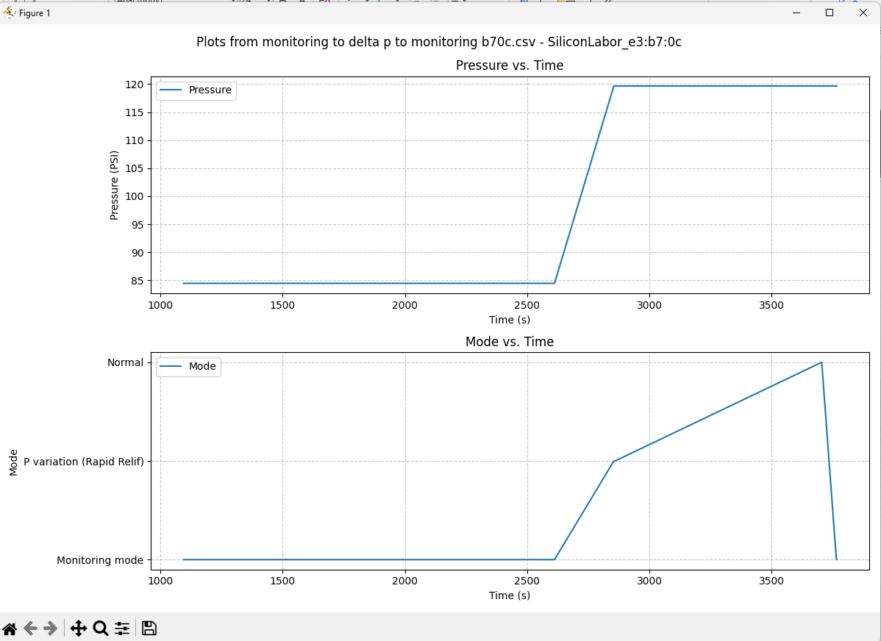
Monitoring to Delta P to Monitoring(B7:0C)

Slide 45
Monitoring to Delta P to Monitoring(48:81)
Time | Pressure Applied | Mode | No of packets ch 37 | No of packets ch 38 | No of packets ch 39 | Pressure on BLE | Time Delta
8:54 AM | 85 PSI | MONITORING | 1 | 4 | 0 | 84.48 PSI | 0
9:19 AM | 85 PSI | MONITORING | 1 | 2 | 1 | 84.48 PSI | 25 min
9:22 AM | 120 PSI
9:22 AM | 120 PSI | DELTA P | 13 | 8 | 7 | 119.65 PSI | 3 min
9:36 AM | 120 PSI | NORMAL | 2 | 1 | 3 | 119.65 PSI | 14 min
9:37 AM | 120 PSI | MONITORING | 2 | 2 | 2 | 119.65 PSI | 1 min
Increase pressure from 85 PSI to 120 PSI
Expected Monitoring Mode at 9:44 AM

Slide 46
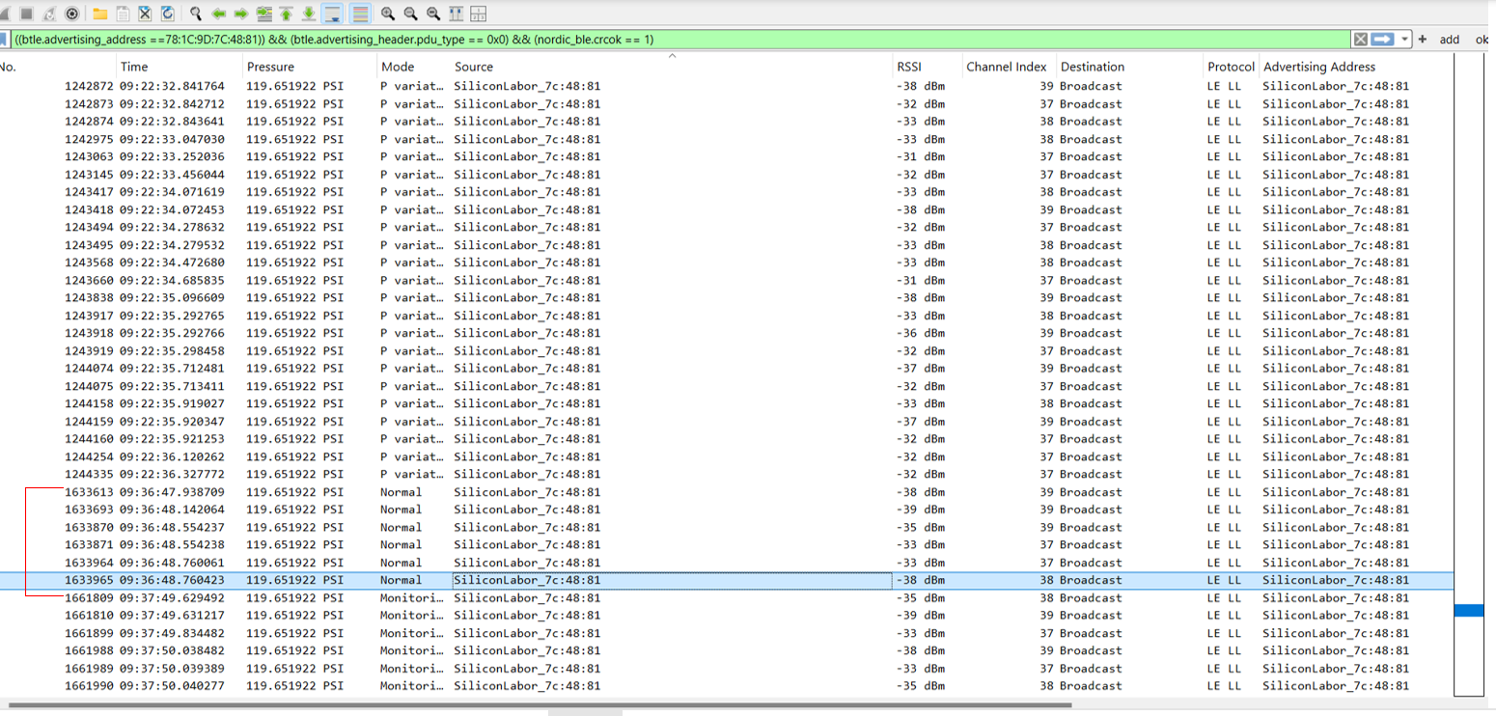
Monitoring to Delta P to Monitoring(48:81)

Slide 47
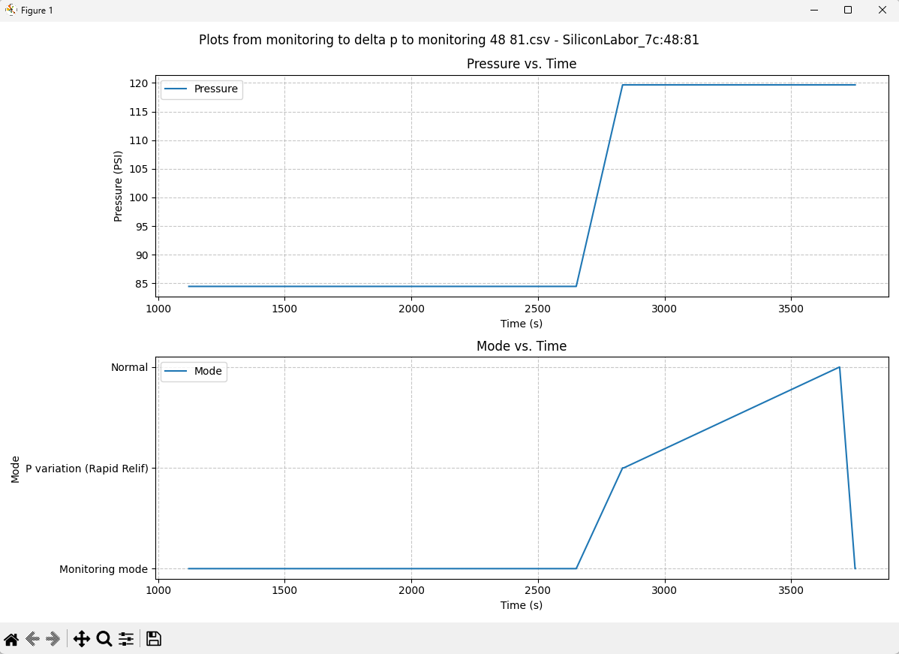
Monitoring to Delta P to Monitoring(48:81)

Slide 48
Conclusion
Monitoring Mode X
Why did the Sensor B7:0C transmit Monitoring Mode packets at 9:38 AM instead of 9:43 AM?
Why did the Sensor 48:81 transmit Monitoring Mode packets at 9:37 AM instead of 9:44 AM?
Monitoring Mode to Delta P Mode ✓
Both the Sensors enter Delta P Mode when a ΔP>=30 PSI is applied while in Monitoring Mode
Delta P Mode to Monitoring Mode X
Why did the Sensor B7:0C first enter Normal Mode at 9:37 AM before returning to Monitoring Mode at 9:38 AM?
Why did the Sensor 48:81 enter Normal Mode at 9:36 AM before returning to Monitoring Mode at 9:37 AM?

